Slide 1
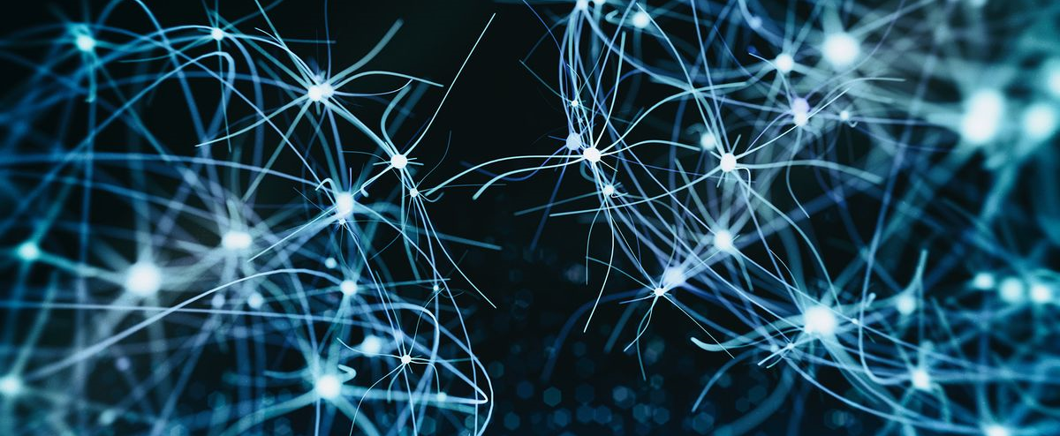

BMB3015 ARTIFICIAL INTELLIGENCE
REGRESSION and CLASSIFICATION

Slide 2
Learning Methods Overview
Classification methods
Logistic regression
Decision trees
K-nearest neighbors
Artifical neural networks
Learning vector quantization
Support vector machines
Clustering methods:
Hieararchical clustering
K-means
Self organizing maps –SOM
Gaussian mixture models
Regression methods
Simple linear regression
Decision (regression) trees
K-nearest neighbours
Artificial neural networks
Reinforcement learning
Temporal difference learning
Q-learning
Anomaly detection
Recommendation systems
Collaborative filtering
Association rules
Notes:
Association Rules
Market analysis
Which products are sold together?
Shelf arrangement
Which products should be replaced together?
Promotions
Which products should be given along with what?

Slide 3
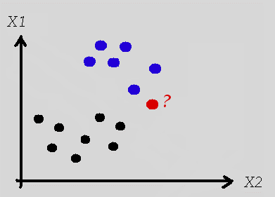
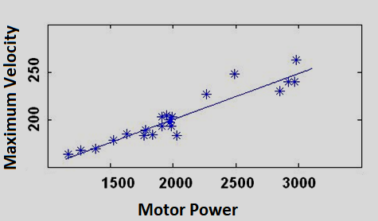
Classification versus Regression
Data usually has the true labels
blue or black
Answers are labels from 1 to N
N is the number of classes
Data represented by features
X1 and X2
Data usually has the true values
250.75, 10.9, ...
Answers are real numbers
maximum velocity: [0, 300]
Data represented by features
Motor power
Notes:
Which class the red one belongs to?

Slide 4
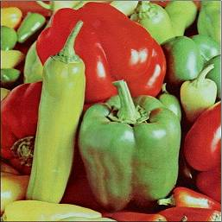
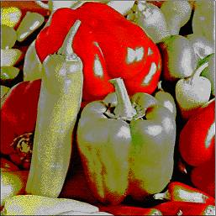
Clustering
Data does not have the true labels
Answers are guessed labels
Data is again represented by features
How to reduce 256 colors to 16 colors?
Features: RGB colors of the pixels
Guessed labels: A set of integers each corresponding to an RGB color

Slide 5
Data Digitization
Image | RGB values of each pixel btw [0-255] or [0-1] in colored images The intensity values btw [0-255] or [0-1] in gray level images A colored image is a Width x Height x 3 matrix A gray-level image is a Width x Height x 1 matrix
Text | Letters, syllables and words are coded with numbers usually depending on their frequencies
Moving Image | Additionally includes time information for an image Similar to having N images for a limited time range A moving colored image is N x Width x Height x 3 matrix
Audio | Sound is coded with its amplitude and frequency changes in time

Slide 6
Classification Example
Design of a system to convert characters on scanned book pages into text.
Initially lines are determined in the page images.
Then the characters are determined in the lines.
A database of labeled sample images for each character is generated.

Slide 7
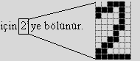
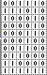
Classification Example
For each character the data is represented as,
[…]_{10x6} matrix = [...]_{1x60} vector

Slide 8
Classification Example
For each character many [...]_{1x60} sample vectors with different fonts are prepared. This means that,
the number of features are 60 for each sample, or
a sample is represented in a 60-dimensional space.
If 10 samples are collected for each of 10 characters, then the data set includes X = [...]_{100x60} matrix and Y = [...]_{100x1} vector.
X is the data matrix with 100 samples and 60 features
Y is the character class labels vector for 100 samples
This dataset is split into 2 parts to have a training set and a testing set.

Slide 9
Classification Example
Training data is input to a classifier which constructs a model for the data.
The constructed model estimates the labels of the test samples.
Test samples are not previously input to the classifier.
Thus the accuracy of the model is evaluated.
Performance criterion is the rate of similarity between the estimated labels and the real labels of the test samples.
Test data
Training data
Classifier
Model
Evaluation
Labels

Slide 10
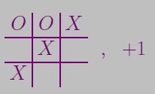
Inductive Learning
Simplest form is to learn a function from examples
f is the target function
An example is a pair (x, f(x)), e.g.
Problem: find a hypothesis h
such that h ≈ f, given a training set of examples
This is a highly simplified model of real learning:
Ignores prior knowledge
Assumes a deterministic, observable environment
Assumes examples are given
Assumes that the agent wants to learn f. Why?
Generalization!

Slide 11
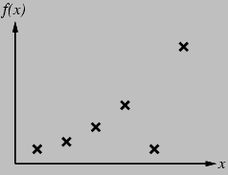
Inductive Learning
Construct/adjust h to agree with f on training set
h is consistent if it agrees with f on all examples
e.g., curve fitting:

Slide 12
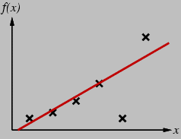
Inductive Learning
Construct/adjust h to agree with f on training set
h is consistent if it agrees with f on all examples
e.g., curve fitting:

Slide 13
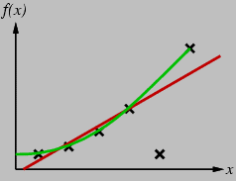
Inductive Learning
Construct/adjust h to agree with f on training set
h is consistent if it agrees with f on all examples
e.g., curve fitting:

Slide 14
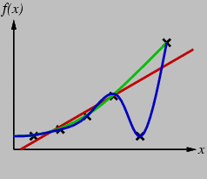
Inductive Learning
Construct/adjust h to agree with f on training set
h is consistent if it agrees with f on all examples
e.g., curve fitting:

Slide 15
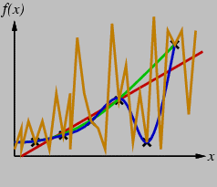
Inductive Learning
Construct/adjust h to agree with f on training set
h is consistent if it agrees with f on all examples
e.g., curve fitting:

Slide 16
Inductive Learning
Construct/adjust h to agree with f on training set
h is consistent if it agrees with f on all examples
e.g., curve fitting:
Ockham’s razor:
prefer the simplest hypothesis consistent with data
Consistency requires use of proper hypothesis space
A hypothesis space consisting of polynomials of finite degree cannot represent sinusoidal functions.

Slide 17
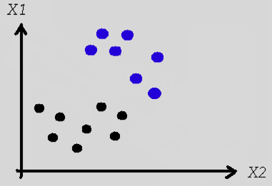
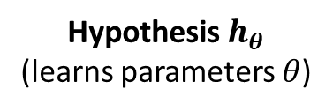
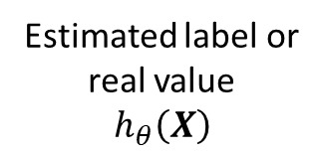
Hypothesis
Hypothesis $h_{θ}$
(learns parameters $θ$)
Estimated label or real value
$$h_{θ}\left(X\right)$$
Data
[X , Y]
Hypothesis
is a mathematical model
Its parameters can be learned from the training samples
can be later used to estimate the labels or real numbers for the testing data
Notes:
Which class the red one belongs to?

Slide 18
Regression Algorithms
Simple linear regression
Regression trees
K-nearest neighbours (KNN)
Artificial neural networks (ANN)

Slide 19
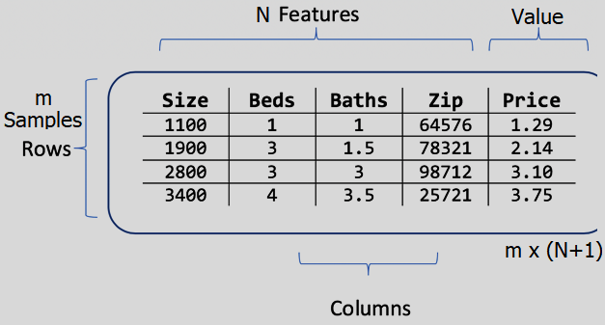
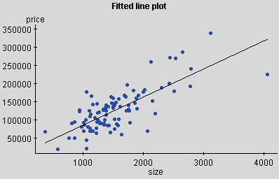
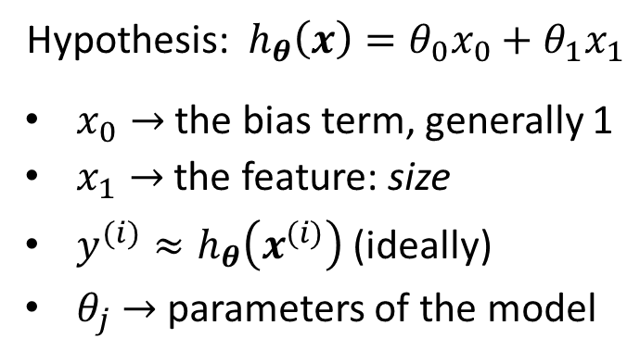
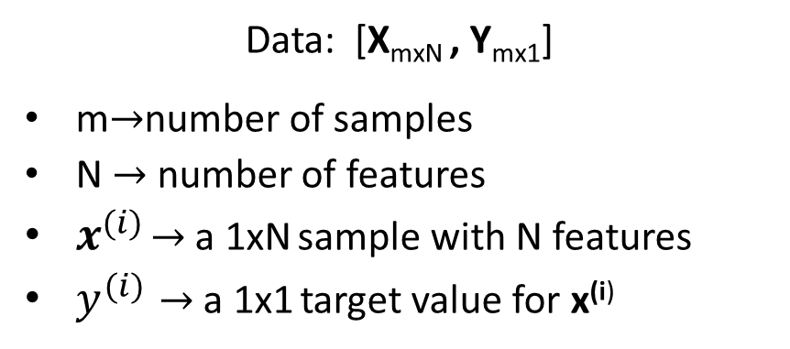
Single-Variable Linear Regression
Data: [X_{mxN} , Y_{mx1}]
m$→$number of samples
N $→$ number of features
$x^{(i)}$ $→$ a 1xN sample with N features
$y^{(i)}→$ a 1x1 target value for x^{(i)}
Hypothesis: $h_{θ}\left(x\right)=θ_{0}x_{0}+θ_{1}x_{1}$
$x_{0}→$ the bias term, generally 1
$x_{1}→$ the feature: size
$y^{(i)}≈h_{θ}\left(x^{(i)}\right)$ (ideally)
$θ_{j}$ $→$ parameters of the model

Slide 20
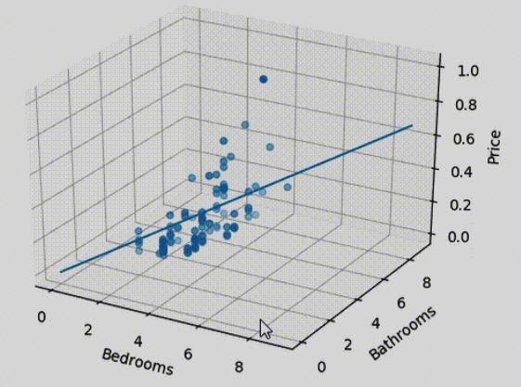
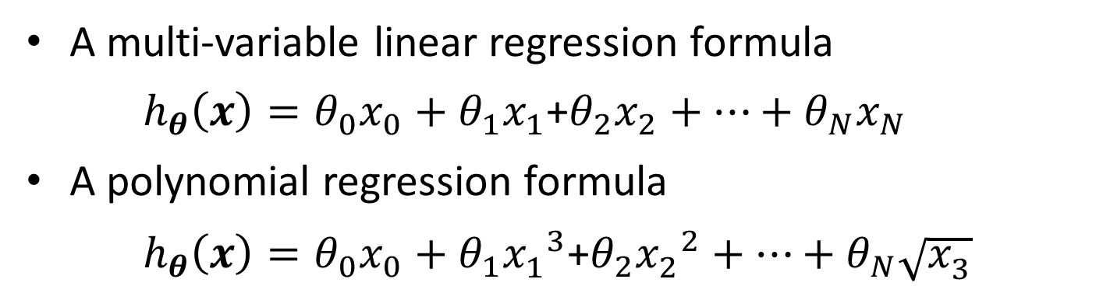
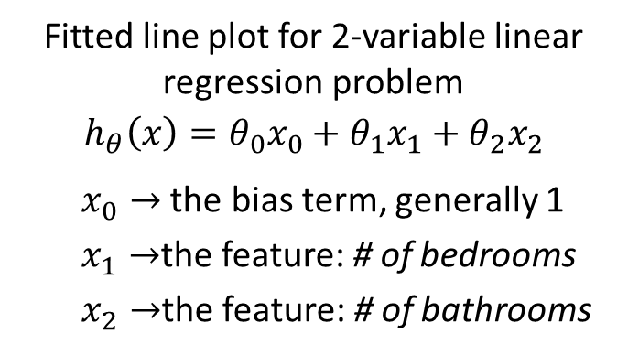
Multi-Variable Linear Regression
A multi-variable linear regression formula
$h_{θ}\left(x\right)=θ_{0}x_{0}+θ_{1}x_{1}$+$θ_{2}x_{2}+…+θ_{N}x_{N}$
A polynomial regression formula
$h_{θ}\left(x\right)=θ_{0}x_{0}+θ_{1}{x_{1}^{ }}^{3}$+$θ_{2}{x_{2}^{ }}^{2}+…+θ_{N}\sqrt{x_{3}^{ }}$
Fitted line plot for 2-variable linear regression problem
$$h_{θ}\left(x\right)=θ_{0}x_{0}+θ_{1}x_{1}+θ_{2}x_{2}$$
$x_{0}→$ the bias term, generally 1
$x_{1}→$the feature: # of bedrooms
$x_{2}→$the feature: # of bathrooms

Slide 21
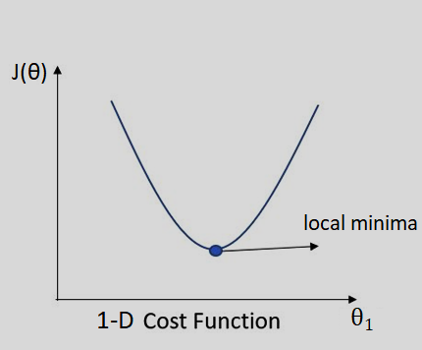
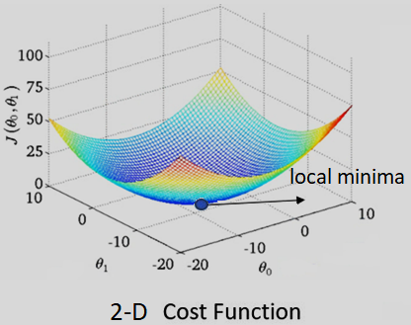
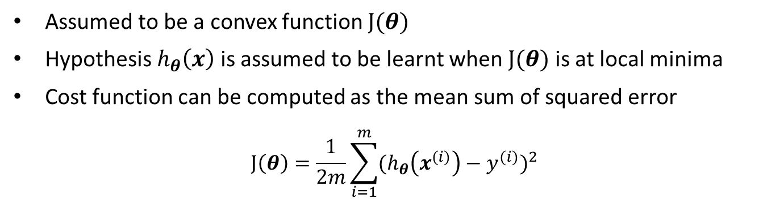
Linear Regression: Cost Function
Assumed to be a convex function $J(θ)$
Hypothesis $h_{θ}\left(x\right)$ is assumed to be learnt when $J(θ)$ is at local minima
Cost function can be computed as the mean sum of squared error
$$J\left(θ\right)=\frac{1}{2m}\sum_{i=1}^{m}{{(h_{θ}\left(x^{(i)}\right)−y^{(i)})}^{2}}$$
Notes:
a twice-differentiable function of a single variable, if its second derivative is always nonnegative on its entire domain, then the function is convex.
a real-valued function defined on an n-dimensional interval is called convex if the line segment between any two points on the graph of the function lies above or on the graph.

Slide 22
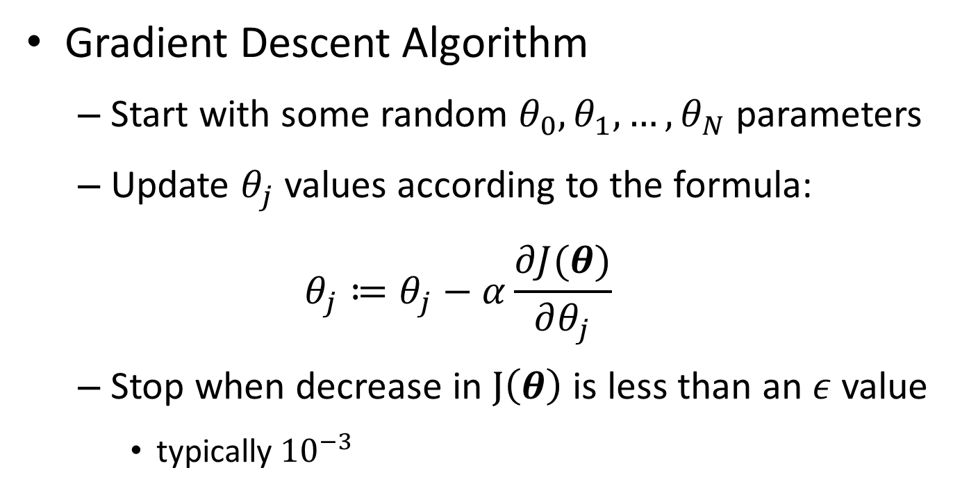
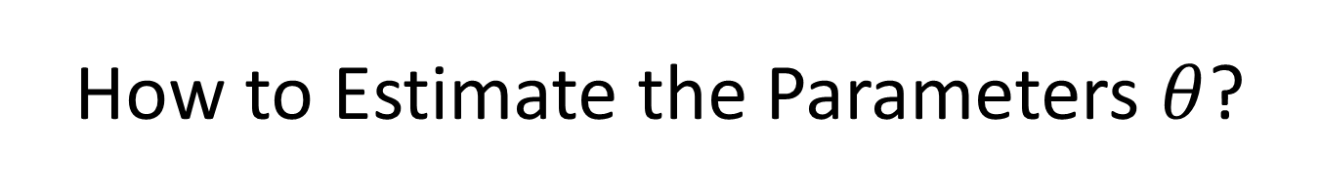
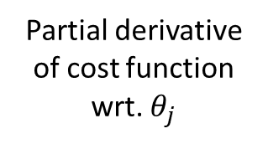
How to Estimate the Parameters $θ$?
Gradient Descent Algorithm
Start with some random $θ_{0},θ_{1},…,θ_{N}$ parameters
Update $θ_{j}$ values according to the formula:
$$θ_{j}≔θ_{j}−α\frac{∂J(θ)}{∂θ_{j}}$$
Stop when decrease in $J\left(θ\right)$ is less than an $ε$value
typically ${10}^{−3}$
Partial derivative of cost function wrt. $θ_{j}$
learning rate

Slide 23
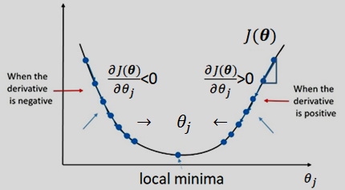
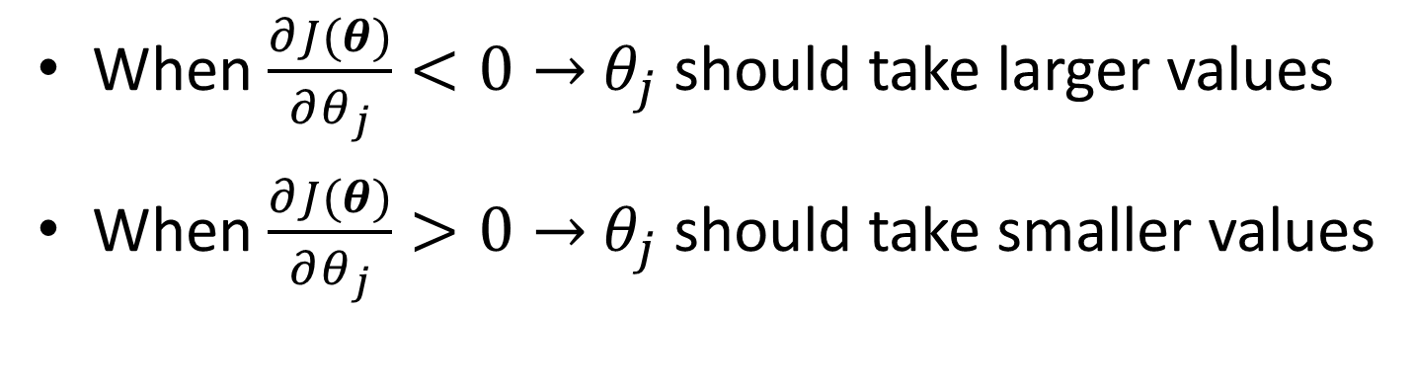
Derivative of the Cost Function
When $\frac{∂J(θ)}{∂θ_{j}}<0→$ $θ_{j}$ should take larger values
When $\frac{∂J(θ)}{∂θ_{j}}>0→$ $θ_{j}$ should take smaller values

Slide 24
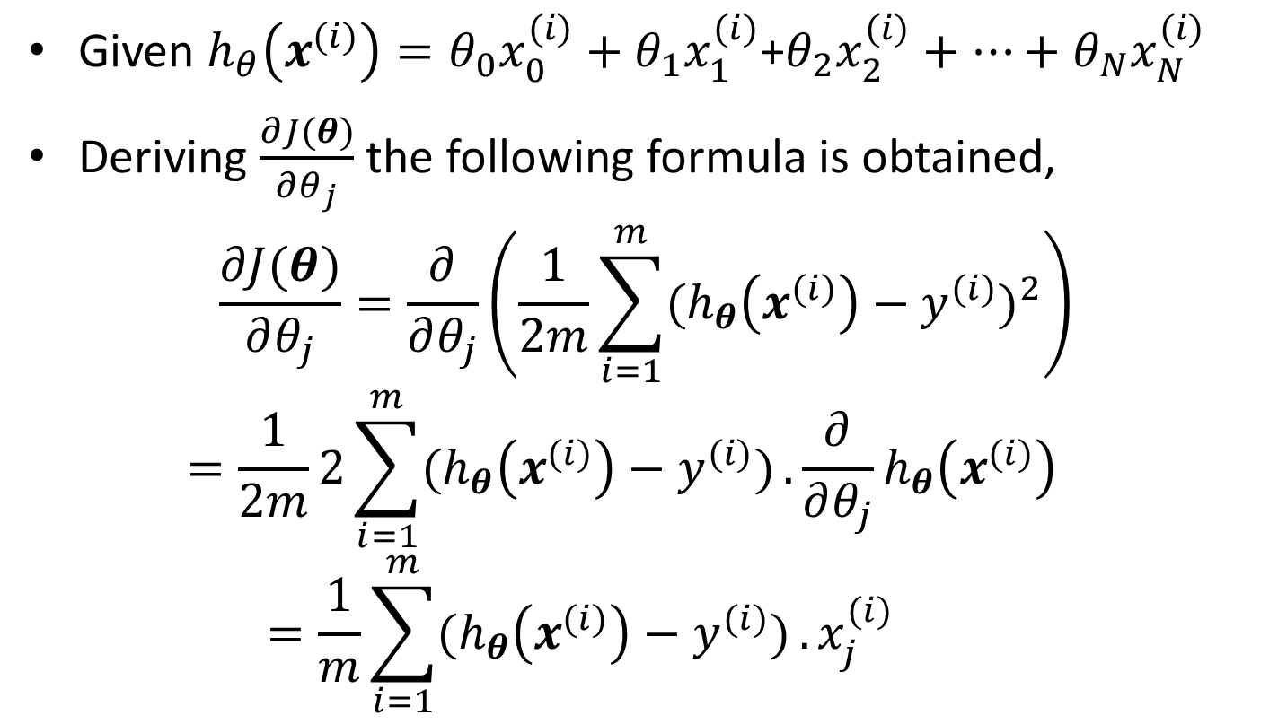
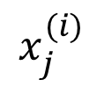
Derivative of the Cost Function
Given $h_{θ}\left(x^{(i)}\right)=θ_{0}x_{0}^{(i)}+θ_{1}x_{1}^{(i)}$+$θ_{2}x_{2}^{(i)}+…+θ_{N}x_{N}^{(i)}$
Deriving $\frac{∂J(θ)}{∂θ_{j}}$ the following formula is obtained,
$$\frac{∂J(θ)}{∂θ_{j}}=\frac{∂}{∂θ_{j}}\left(\frac{1}{2m}\sum_{i=1}^{m}{{(h_{θ}\left(x^{(i)}\right)−y^{(i)})}^{2}}\right)$$
$$=\frac{1}{2m}2\sum_{i=1}^{m}{(h_{θ}\left(x^{(i)}\right)−y^{(i)})}.\frac{∂}{∂θ_{j}}h_{θ}\left(x^{(i)}\right)=\frac{1}{m}\sum_{i=1}^{m}{(h_{θ}\left(x^{(i)}\right)−y^{(i)})}.x_{j}^{(i)}$$
$$x_{j}^{(i)}$$

Slide 25
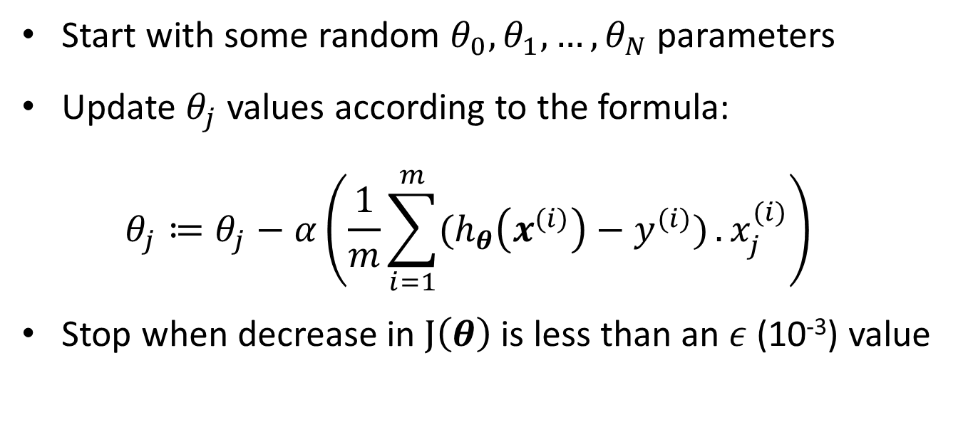
Gradient Descent
Start with some random $θ_{0},θ_{1},…,θ_{N}$ parameters
Update $θ_{j}$ values according to the formula:
$$θ_{j}≔θ_{j}−α\left(\frac{1}{m}\sum_{i=1}^{m}{(h_{θ}\left(x^{(i)}\right)−y^{(i)})}.x_{j}^{(i)}\right)$$
Stop when decrease in $J\left(θ\right)$ is less than an $ε$(10⁻³) value

Slide 26
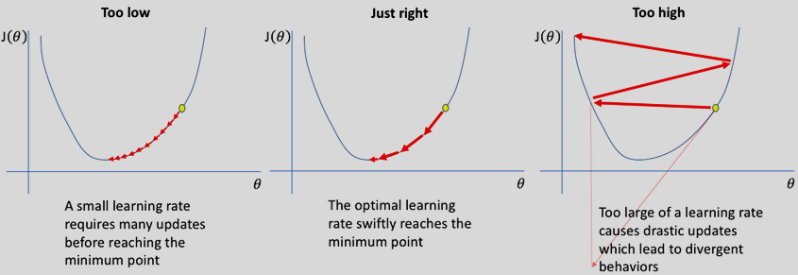

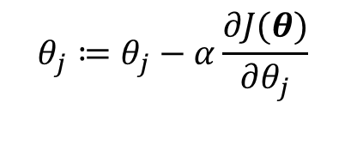
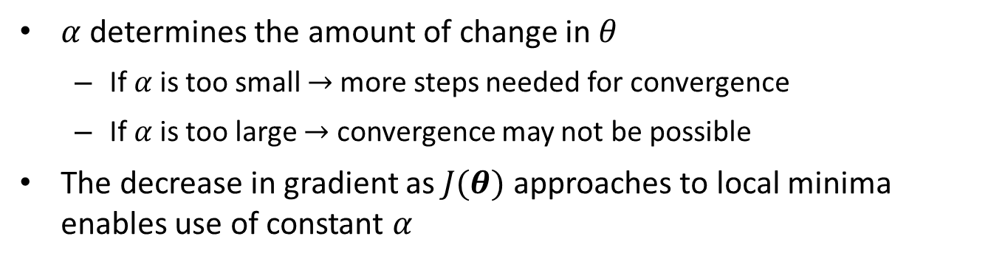
Learning Rate $α$
$α$ determines the amount of change in $θ$
If $α$is too small $→$more steps needed for convergence
If $α$is too large $→$ convergence may not be possible
The decrease in gradient as $J(θ)$ approaches to local minima enables use of constant $α$
$$θ_{j}≔θ_{j}−α\frac{∂J(θ)}{∂θ_{j}}$$

Slide 27
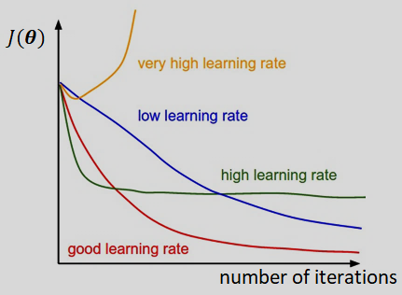
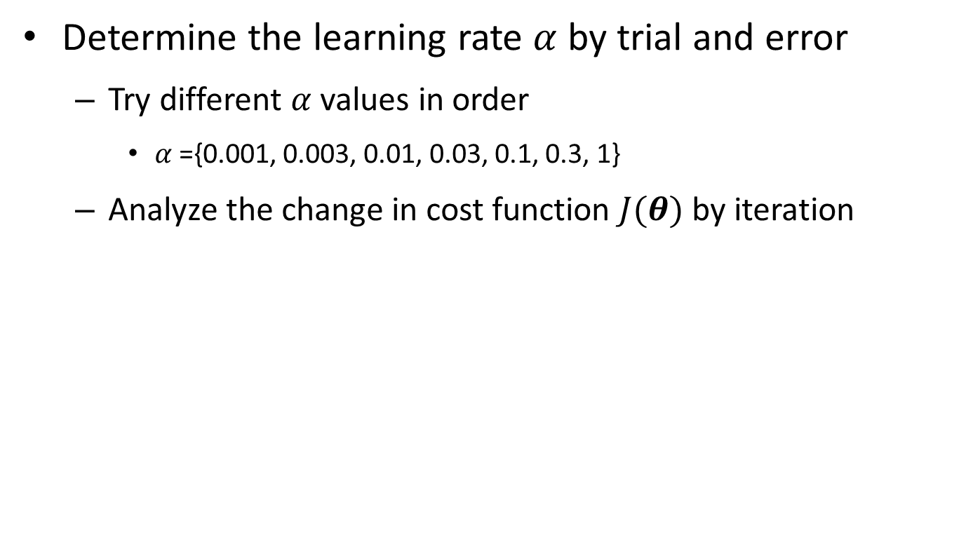

Assignment of $α$ Value
Determine the learning rate $α$ by trial and error
Try different $α$values in order
$α$={0.001, 0.003, 0.01, 0.03, 0.1, 0.3, 1}
Analyze the change in cost function $J(θ)$ by iteration

Slide 28
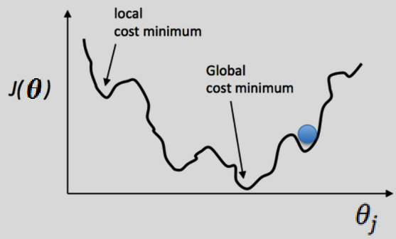
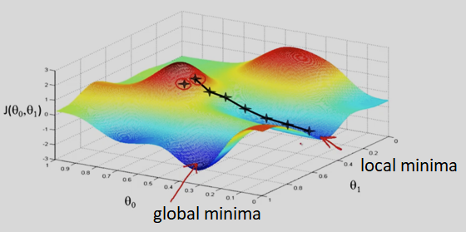
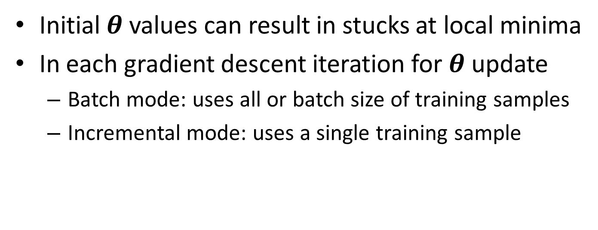

$θ$Values Initialization
Initial $θ$values can result in stucks at local minima
In each gradient descent iteration for $θ$ update
Batch mode: uses all or batch size of training samples
Incremental mode: uses a single training sample

Slide 29
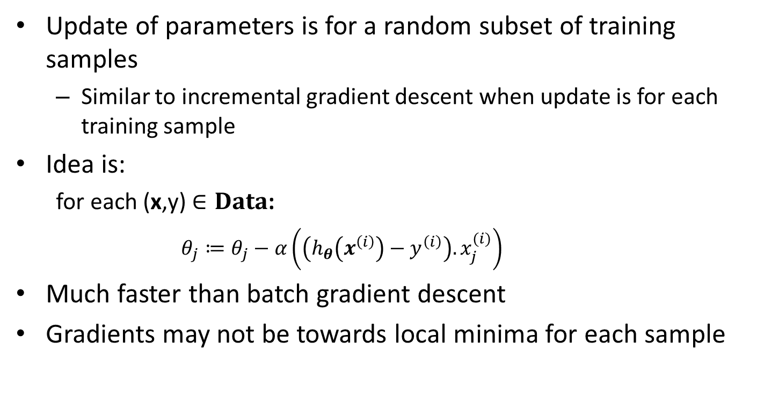
Stochastic Gradient Descent
Update of parameters is for a random subset of training samples
Similar to incremental gradient descent when update is for each training sample
Idea is:
for each (x,y) $∈Data$:
$$θ_{j}≔θ_{j}−α\left(\left(h_{θ}\left(x^{\left(i\right)}\right)−y^{\left(i\right)}\right).x_{j}^{(i)}\right)$$
Much faster than batch gradient descent
Gradients may not be towards local minima for each sample

Slide 30
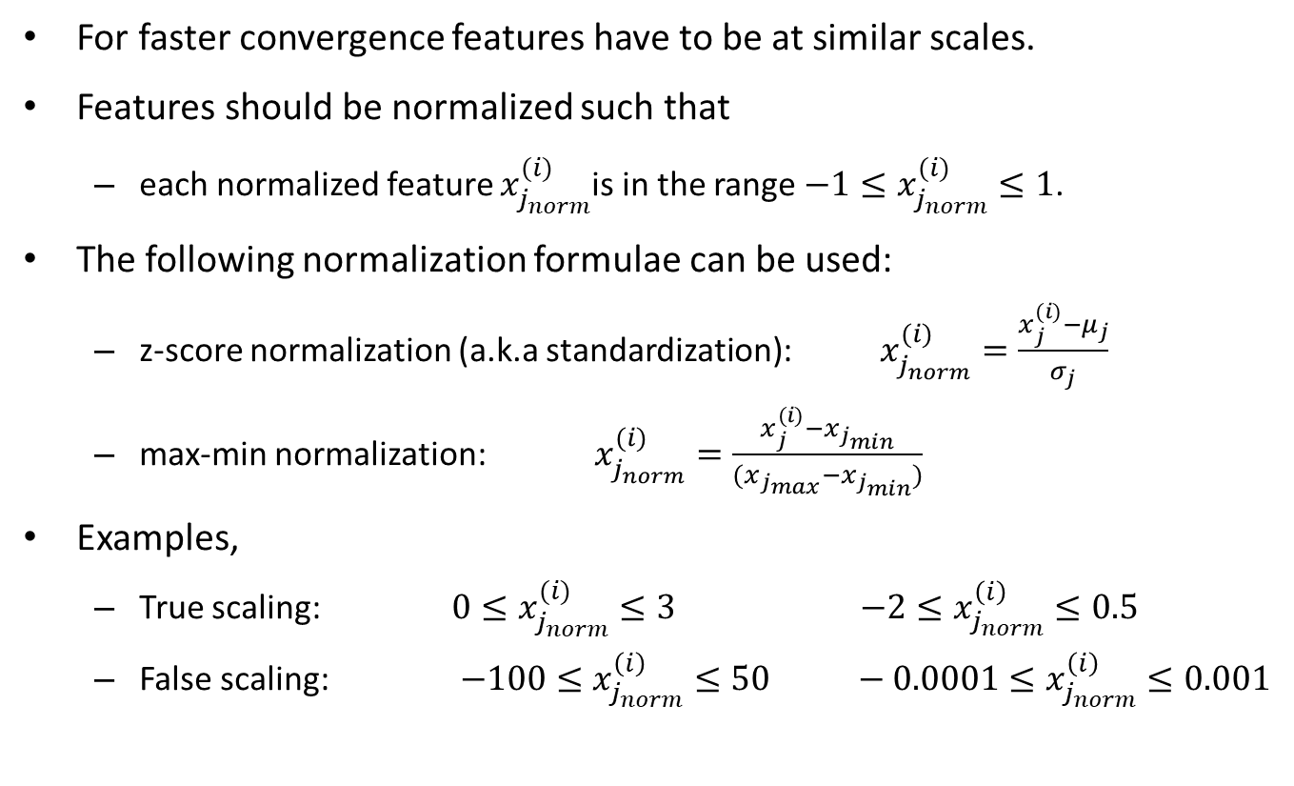
Feature Normalization
For faster convergence features have to be at similar scales.
Features should be normalized such that
each normalized feature $x_{j_{norm}}^{(i)}$is in the range $−1≤x_{j_{norm}}^{(i)}≤1$.
The following normalization formulae can be used:
z-score normalization (a.k.a standardization): $x_{j_{norm}}^{(i)}=\frac{x_{j}^{(i)}−μ_{j}}{σ_{j}}$
max-min normalization: $x_{j_{norm}}^{(i)}=\frac{x_{j}^{(i)}−x_{j_{min}}}{(x_{j_{max}}−x_{j_{min}})}$
Examples,
True scaling: $0≤x_{j_{norm}}^{(i)}≤3$ $−2≤x_{j_{norm}}^{\left(i\right)}≤0.5$
False scaling: $−100≤x_{j_{norm}}^{\left(i\right)}≤50 −0.0001≤x_{j_{norm}}^{\left(i\right)}≤0.001$

Slide 31
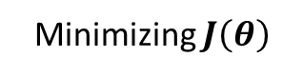
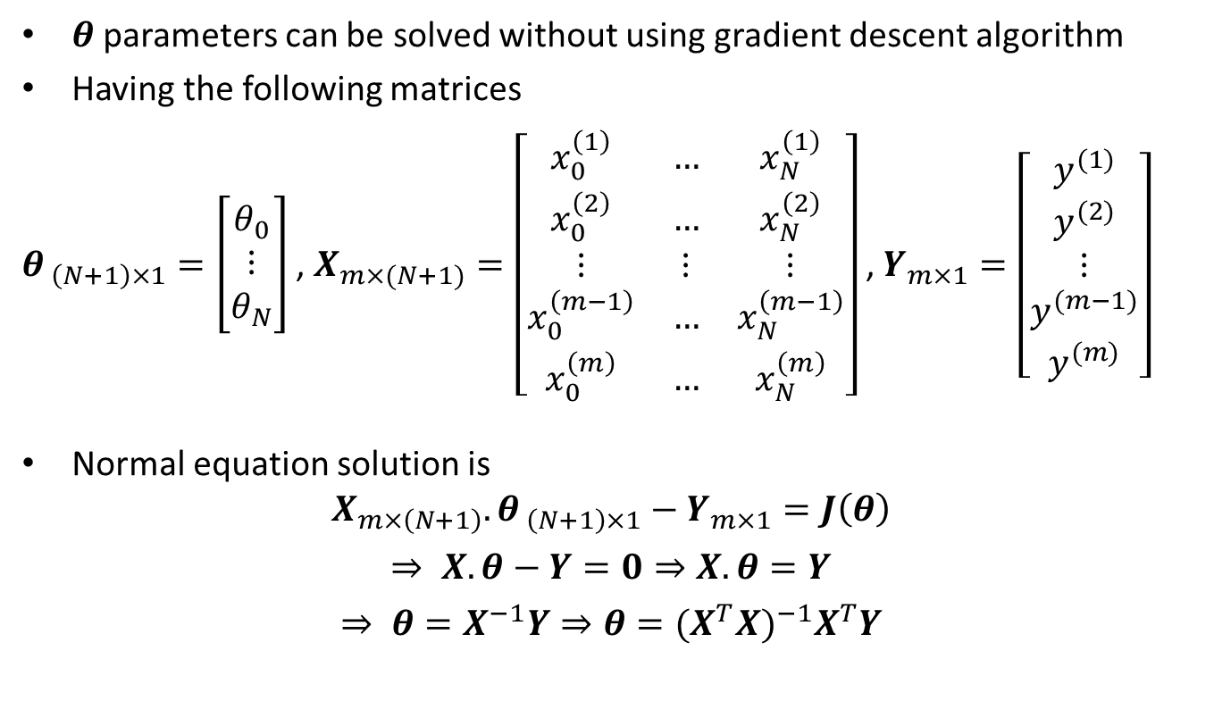
Normal Equation Solution
$θ$parameters can be solved without using gradient descent algorithm
Having the following matrices
$θ_{ \left(N+1\right)×1}=\left[\begin{matrix}θ_{0} \\ ⋮ \\ θ_{N}\end{matrix}\right]$ , $X_{m×(N+1)}=\left[\begin{matrix}x_{0}^{\left(1\right)} & … & x_{N}^{\left(1\right)} \\ x_{0}^{\left(2\right)} & … & x_{N}^{\left(2\right)} \\ ⋮ & ⋮ & ⋮ \\ x_{0}^{\left(m−1\right)} & … & x_{N}^{\left(m−1\right)} \\ x_{0}^{\left(m\right)} & … & x_{N}^{\left(m\right)}\end{matrix}\right]$ , $Y_{m×1}=\left[\begin{matrix}\begin{matrix}y^{(1)} \\ y^{(2)} \\ ⋮\end{matrix} \\ y^{(m−1)} \\ y^{(m)}\end{matrix}\right]$
Normal equation solution is
$$X_{m×\left(N+1\right)}.θ_{ \left(N+1\right)×1}−Y_{m×1}=J\left(θ\right)$$
$$⇒ X.θ−Y=0⇒X.θ=Y$$
$$⇒ θ=X^{−1}Y⇒θ={{(X^{T}X)}^{−1}X}^{T}Y$$
Minimizing $J\left(θ\right)$

Slide 32
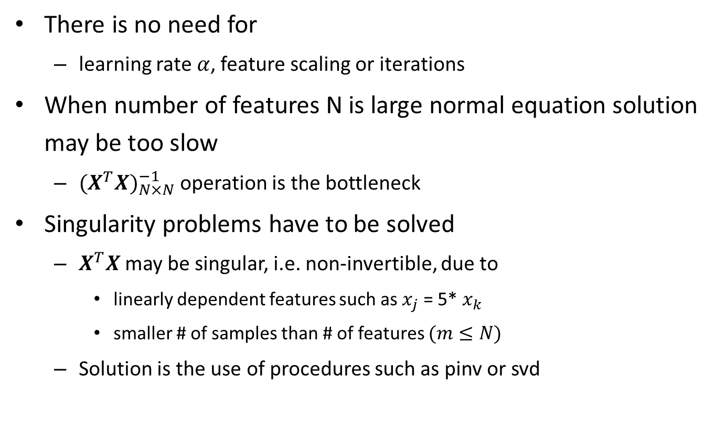
Normal Equation Solution: Pros and Cons
There is no need for
learning rate $α$, feature scaling or iterations
When number of features N is large normal equation solution may be too slow
${(X^{T}X)}_{N×N}^{−1}$ operation is the bottleneck
Singularity problems have to be solved
$X^{T}X$ may be singular, i.e. non-invertible, due to
linearly dependent features such as $x_{j}$ = 5* $x_{k}$
smaller # of samples than # of features $(m≤N)$
Solution is the use of procedures such as pinv or svd

Slide 33
Classification Algorithms
Logistic regression
Decision trees
K nearest neighbours (KNN)
Artificial neural networks (ANN)

Slide 34
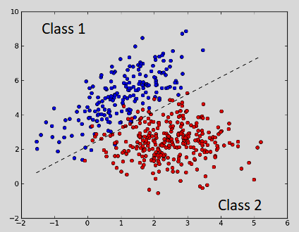
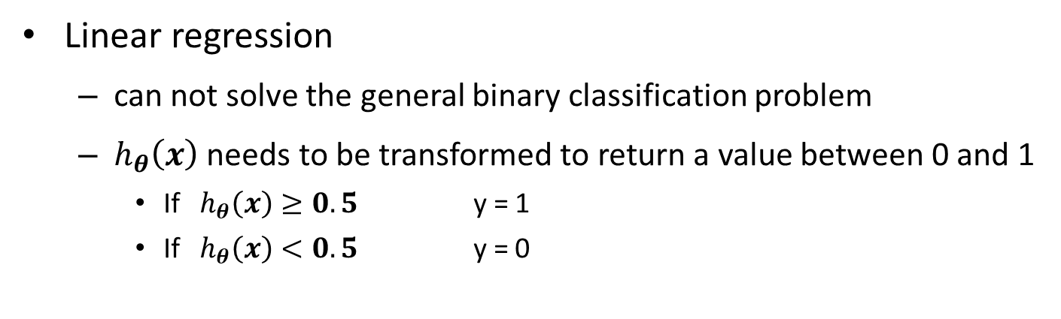
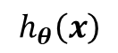
Logistic Regression
Linear regression
can not solve the general binary classification problem
$h_{θ}\left(x\right)$ needs to be transformed to return a value between 0 and 1
If $h_{θ}\left(x\right)≥0.5$ y = 1
If $h_{θ}\left(x\right)<0.5$ y = 0
$$h_{θ}\left(x\right)$$
Logistic regression
a classification algorithm despite the «regression» term
can solve binary classification problems

Slide 35


Logistic Regression
wants to have 0$≤h_{θ}\left(x\right)≤1$
$h_{θ}\left(x\right)=g(xθ)$
$g$is sigmoid function, or logistic function
$g\left(z\right)=\frac{1}{1+e^{−z}}$
The hypothesis $h_{θ}\left(x\right)$,
$h_{θ}\left(x\right)=\frac{1}{1+e^{−xθ}}$

Slide 36

Logistic Regression
If $z≥0$ then $g\left(z\right)≥0.5$,
If $xθ≥0, h_{θ}\left(x\right)$= $g\left(xθ\right)$ $≥0.5$
then $y=1$
If $z<0$ then $g\left(z\right)<0.5$,
If $xθ<0, h_{θ}\left(x\right)$= $g\left(xθ\right)$ $<0.5$
then $y=0$
$h_{θ}\left(x\right)$is considered to give the probability P(y=1|$x, θ$)
P(y=1|$x, θ$)+P(y=0|$x, θ$) = 1 for binary classification problem

Slide 37













Linear Decision Boundary
$h_{θ}\left(x\right)=g(θ_{0}x_{0}+θ_{1}x_{1}$+$θ_{2}x_{2})$
Decision boundary
$$y−x−2=0$$
$$y+1.5x−12=0$$
$$y=1$$
$$y=1$$
$$y−x−2≥0$$
$$y+1.5x−12≥0$$
$$y+1.5x−12<0$$
$$y=0$$
$$y=0$$
$$y−x−2<0$$
Notes:
4,6
8,0
m= 6/-4=-3/2
y-6=-3/2(x-4)
2y-12=-3x+12
2y+3x-24=0
y+1.5x-12=0

Slide 38







Non-linear Decision Boundary
A polynomial regression formula
$h_{θ}\left(x\right)=g(θ_{0}x_{0}+{θ_{1}x_{1}\text{+}θ_{2}x_{2}+θ}_{3}{x_{1}^{ }}^{2}$+$θ_{4}{x_{2}^{ }}^{2}$)
$$y=1$$
$$x^{2}+y^{2}≥0.75$$
$$y=0$$
$$x^{2}+y^{2}<0.75$$
$$x^{2}+y^{2}=0.75$$

Slide 39



Complex Decision Boundary
$h_{θ}\left(x\right)=g(θ_{0}x_{0}+θ_{1}{x_{1}^{ }}^{2}{x_{2}^{ }}^{3}$+$θ_{2}{x_{1}^{ }}^{3}{x_{2}^{ }}^{2}+…+θ_{N}\sqrt{x_{3}^{ }})$

Slide 40



Logistic Regression: Cost Function
Linear regression cost function:
$J\left(θ\right)=\frac{1}{2m}\sum_{i=1}^{m}{{(h_{θ}\left(x^{(i)}\right)−y^{(i)})}^{2}}$
$h_{θ}\left(x\right)$ is not linear in logistic regression.
$J\left(θ\right)$ is a non-convex function then
Gradient descent is stuck at local minima
look for this function
-log(z)
Non-convex function
Convex function

Slide 41



Logistic Regression: Cost Function
$Cost(h_{θ}\left(x\right),y)=\left\{\begin{aligned}−\log\left(h_{θ}\left(x\right)\right) if y=1 \\ −\log\left(1−h_{θ}(x)\right) if y=0\end{aligned}\right.$

Slide 42





Logistic Regression: Cost Function
Log Loss (Binary Cross Entropy)
$Cost\left(h_{θ}\left(x\right),y\right)=−y log\left(h_{θ}\left(x\right)\right)−\left(1−y\right)\log\left(1−h_{θ}\left(x\right)\right)$
$J\left(θ\right)=\frac{−1}{m}\left[\sum_{i=1}^{m}{y^{\left(i\right)}\log\left(h_{θ}\left(x^{\left(i\right)}\right)\right)+(1−y^{(i)})}\log\left(1−h_{θ}\left(x^{\left(i\right)}\right)\right)\right]$
$$works if y=1$$
$$works if y=0$$
Punishes $h_{θ}\left(x\right)$=0 when y=1
$h_{θ}\left(x\right)→1,$ $J\left(θ\right)$ $→0$
$h_{θ}\left(x\right)→0,$ $J\left(θ\right)$ $→∞$
Punishes $h_{θ}\left(x\right)$=1 when y=0
$h_{θ}\left(x\right)→0,$ $J\left(θ\right)$ $→0$
$h_{θ}\left(x\right)→1,$ $J\left(θ\right)$ $→∞$

Slide 43


Optimizing $θ$
The same gradient descent algorithm can be used to find optimal $θ$
Gradient Descent:
Start with some random $θ_{0},θ_{1},…,θ_{N}$ parameters
Update $θ_{j}$ values according to the formula:
$$θ_{j}≔θ_{j}−α\left(\frac{1}{m}\sum_{i=1}^{m}{(h_{θ}\left(x^{(i)}\right)−y^{(i)})}.x_{j}^{(i)}\right)$$
Stop when decrease in $J\left(θ\right)$ is less than an $ε$(10⁻³) value
where $h_{θ}\left(x^{(i)}\right)=g\left(x^{\left(i\right)}θ\right)$
$J\left(θ\right)$ is the logistic regression cost function

Slide 44

Other Optimization Algorithms
Some other optimization algorithms
BFGS
L-BFGS
Conjugate-gradient
More complex than the gradient descent
Faster than the gradient descent
No need to set $α$
Computed automatically
Optimization functions in libraries are useful
e.g. fminunc in Matlab uses BFGS
Notes:
Conjugate-gradient: algorithm for the numerical solution of particular systems of linear equations, namely those whose matrix is positive-definite.
n numerical optimization, the Broyden–Fletcher–Goldfarb–Shanno (BFGS) algorithm is an iterative method for solving unconstrained nonlinear optimization problems.

Slide 45

fminunc
function [jVal, gradient]=costFunction(theta)
jVal=…(cost) a single value
gradient=…(partial derivatives of cost with respect to $θ_{j}$. ) a matrix of size $θ×1$)
end
options = optimset('Grdobject', 'on', 'Maxiter', '100');
[optTheta, functionVal, exitFlag]=
fminunc(@costfunction, initialTheta, options);

Slide 46






Multi-Class Classification
Multi-class classification problem is turned into binary classification problem
A new hypothesis $h_{θ}^{j}$(x) is computed for each binary classification problem.

Slide 47

Multi-Class Classification
$h_{θ}^{j}$(x) = p(y=1|x, $θ$) j=1, 2, 3
A test sample $x^{test}$ is assigned to the class j that maximizes $h_{θ}^{j}$($x^{test}$)
$class(x^{test})$ = $\underset{j}{argmax}{h_{θ}^{j}\text{(}x^{test}\text{) }}$

